Slide 1
Assessment : sign Detection
Stijn Uytterhoeven

Slide 2

Task description
Sign detection
Dataset of 10 images
Motion detection
Endpoint

Slide 3
Sign detection

Slide 4
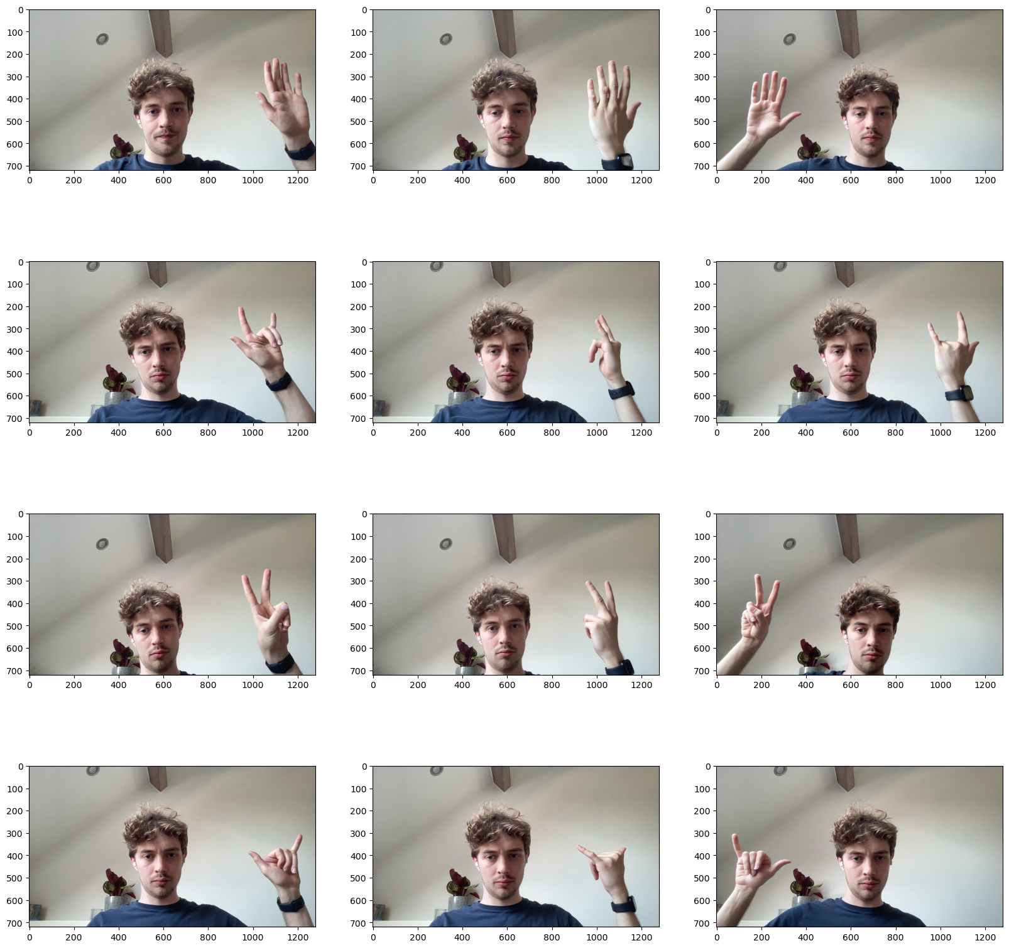
Sign detection
Training data
Open hand, peace, surf, rock on
10 training images, 5 test images for each class

Slide 5
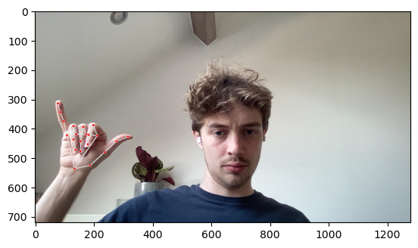
Sign detection
Mediapipe
Handlandmark detection

Slide 6
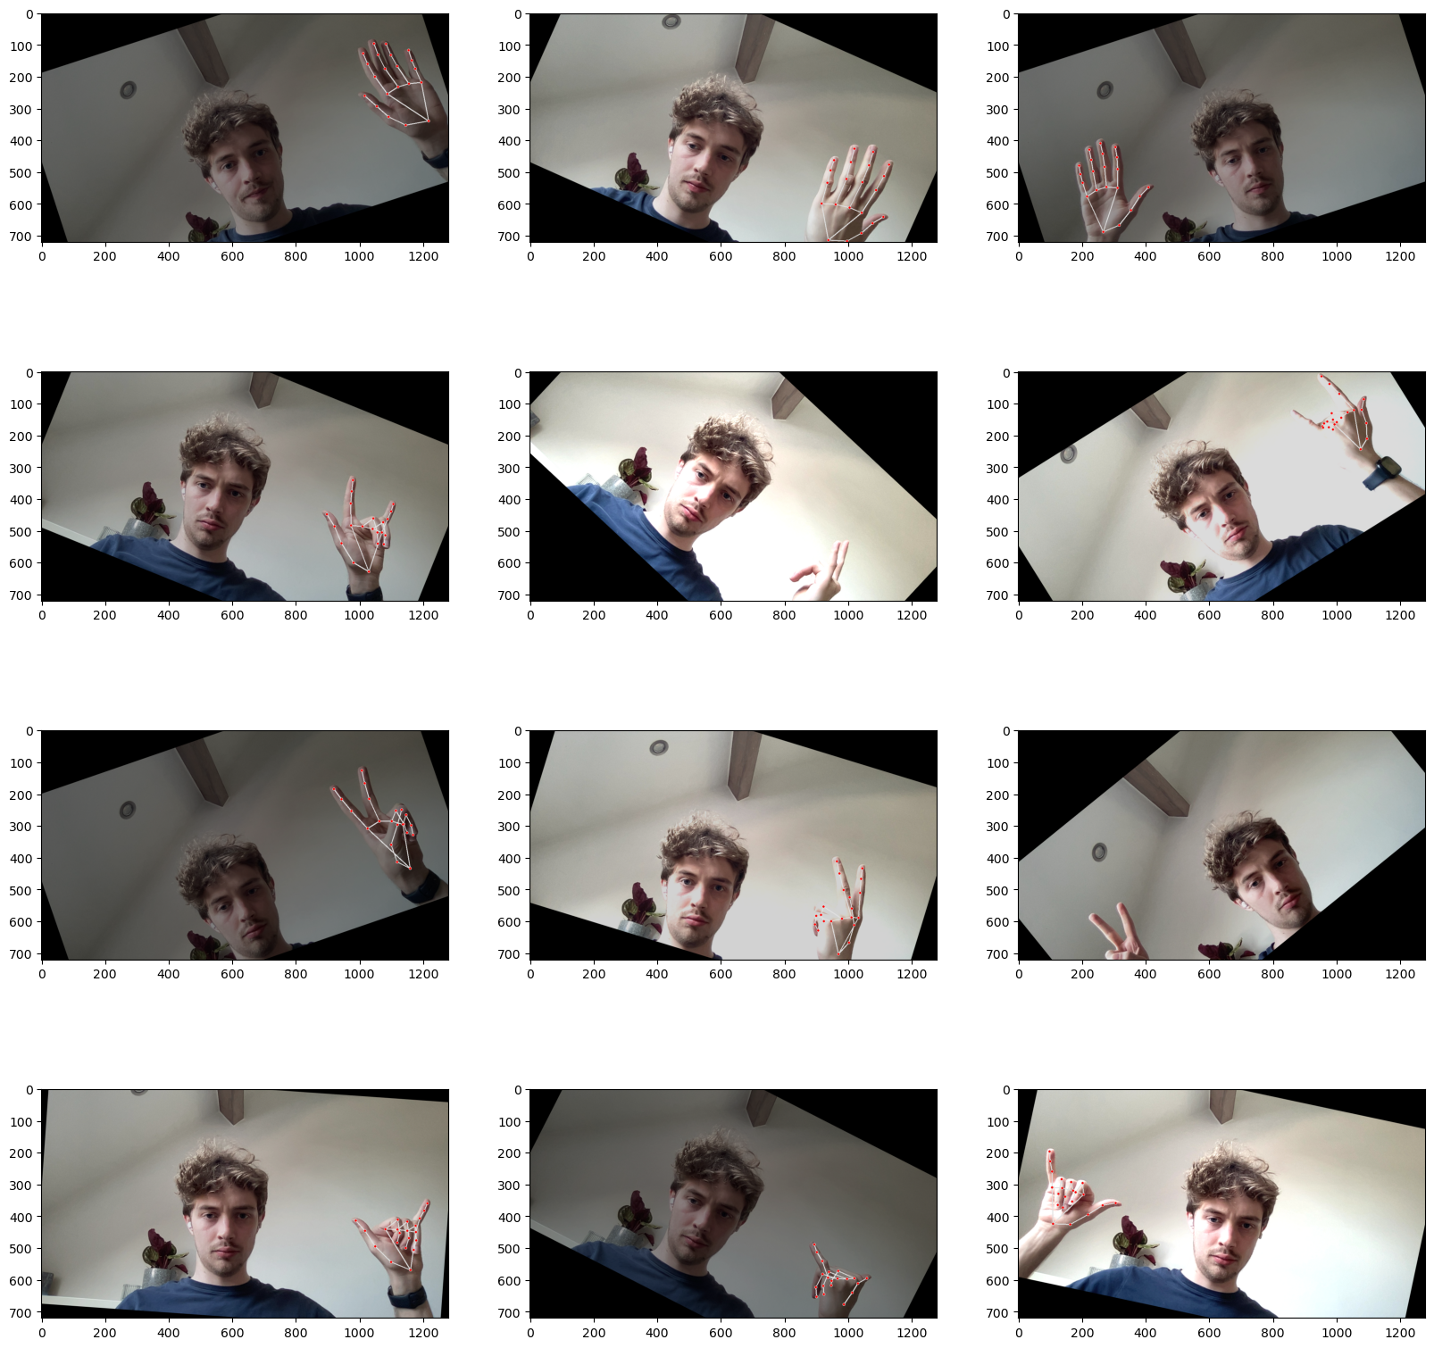
Sign detection
Data augmentation
Rotation
Change brightness
Change contrast

Slide 7
Sign detection
Models
​ | Accuracy​ | F1​
Random forest​ | 0.61​ | 0.61​
Gradient boosting | 0.66 | 0.66
SVC | 0.67 | 0.67
Nearest Neighbours | 0.665 | 0.665
Logistic regression | 0.86​ | 0.86​
Random forest
Gradient boosting
Support vector machine
Nearest neighbours
Logistic regresion

Slide 8
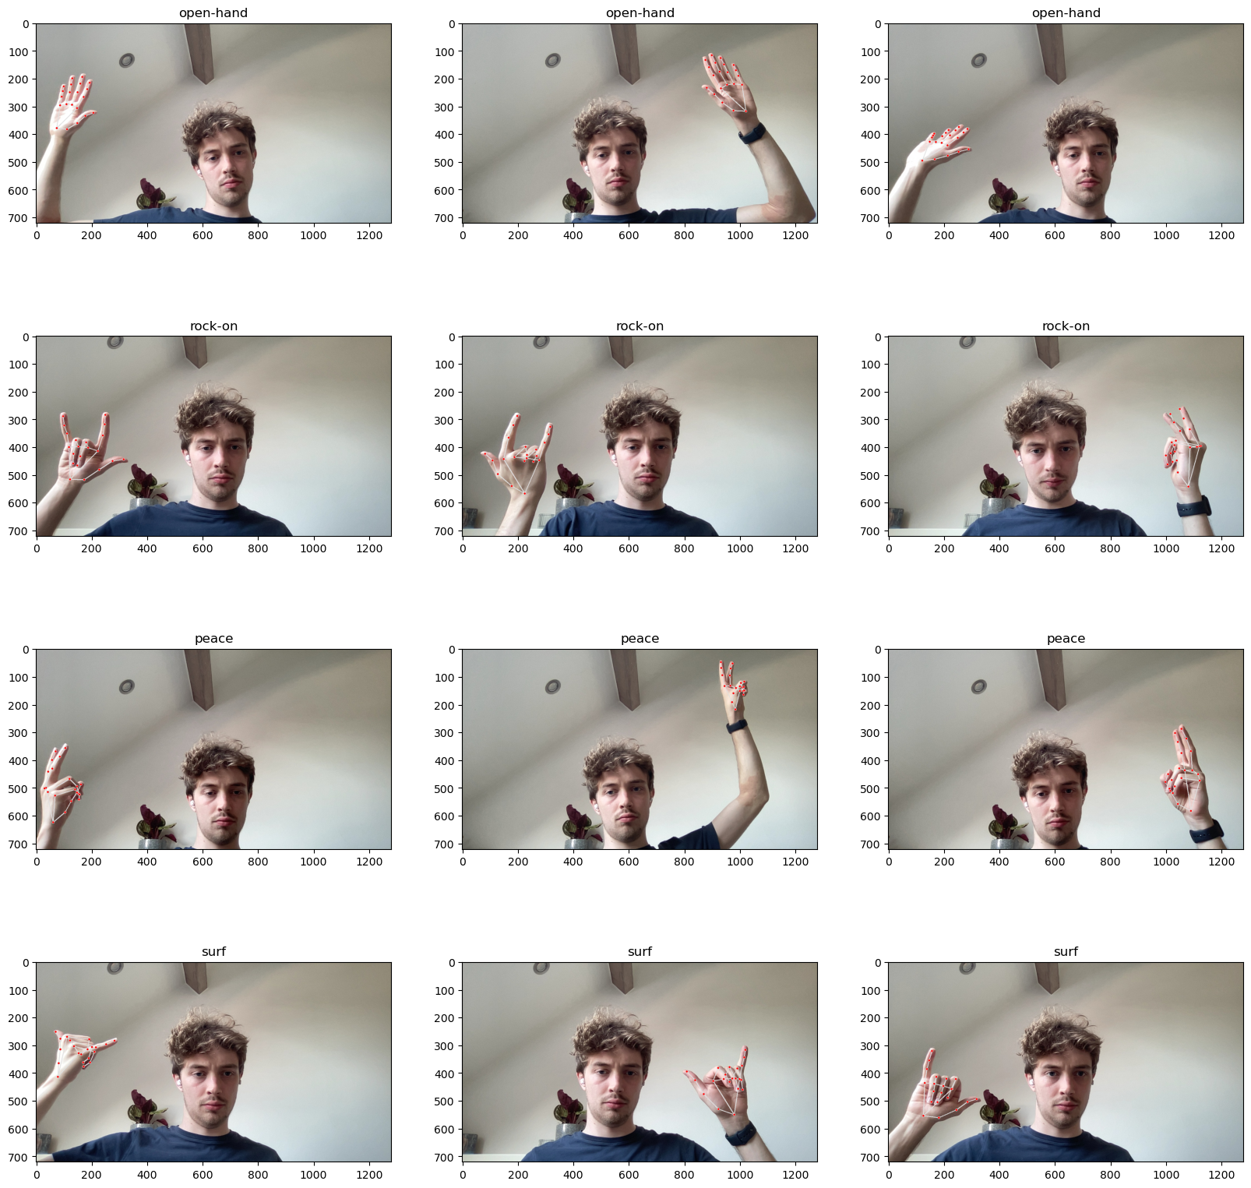
Sign detection
prediction
Endpoint
Predict.py script

Slide 9
Motion detection

Slide 10
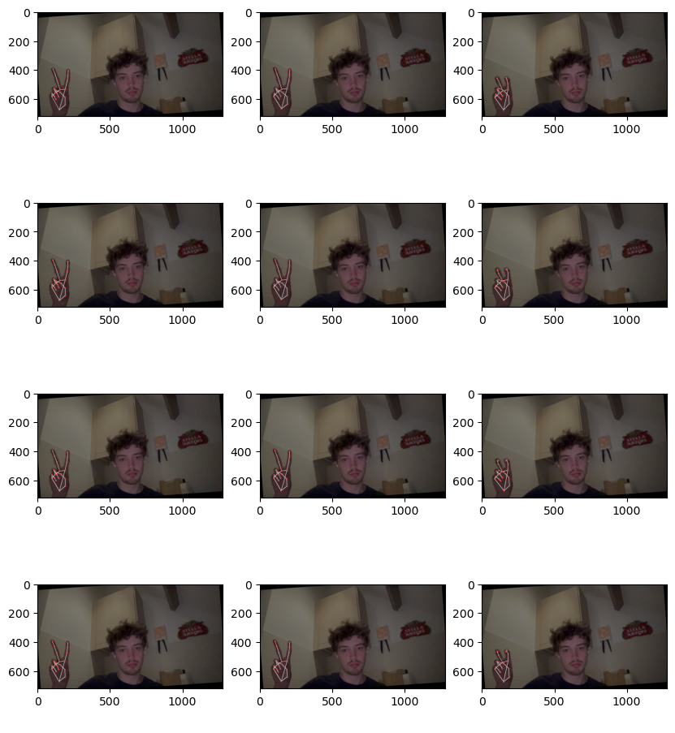
Motion detection
Training data
Opening hand
Moving 2 fingers
Same augmentation
Handlandmarks from mediapipe

Slide 11
Motion detection
model
Neural network using LSTM layers
Accuracy of 0.75 on test set

Slide 12
Motion detection
DEMO TIME!

Slide 13
THANK YOU
Stijn Uytterhoeven
Stijn.uytterhoeven@Skynet.be

